Slide 1
Course Name: Database Management Systems Course Code: CI32/CY32 Credits: 2:0:1 UNIT 3
M.S. Ramaiah Institute of Technology
(Autonomous Institute, Affiliated to VTU)
Faculty:
Dr. Sini Anna Alex

Slide 2
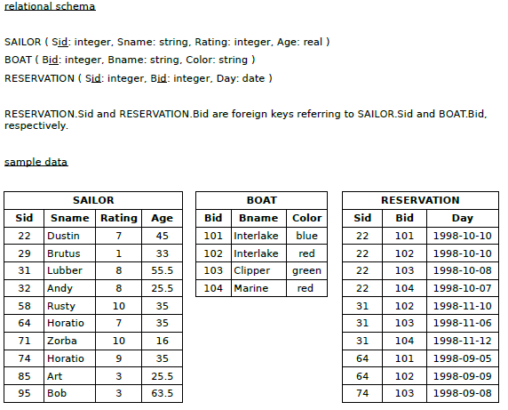
Write SQL Query for the following:
Find the names of sailors over the age of 20.
Find the names of sailors who have reserved a red boat.
Find the colors of boats reserved by Lubber.
Find the names of sailors who have reserved a red boat or a green boat.
Find all sailors whose names start with A.
Find all reservations (date, sailor sids and names, and boat bids and names) for reservations made on the 10th of (any) month during the 1990s.
Determine the age each sailor will be next year.

Slide 3

Solutions
SELECT DISTINCT Sname
FROM ( SAILOR NATURAL JOIN RESERVATION ) NATURAL JOIN BOAT
WHERE Color='red' OR Color='green‘
SELECT *
FROM SAILOR
WHERE Sname LIKE 'A%‘
SELECT Day,Sid,Sname,Bid,Bname
FROM ( SAILOR NATURAL JOIN RESERVATION ) NATURAL JOIN BOAT
WHERE Day LIKE '199___10’

Slide 4
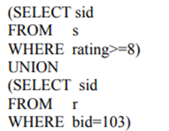
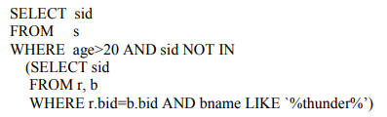
More Query:
Assume Sailor as s
Boat as b
Reservation as r
Find all sailor id’s of sailors who have a rating of at least 8 or reserved boat 103.
Find the sailor id’s of sailors with age over 20 who have not reserved a boat whose name includes the string “thunder”.

Slide 5
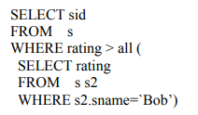
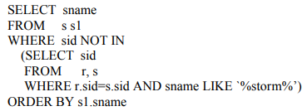
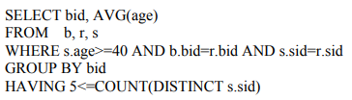
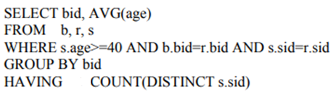
Find the sailor id’s of sailors whose rating is better than every sailor called Bob.
Find the names of sailors who have not reserved a boat whose name contains the string “storm”. Order the names in ascending order.
For each boat which was reserved by at least 5 sailors with age >= 40, find the boat id and the average age of such sailors.
Assume Sailor as s
Boat as b
Reservation as r
OR

Slide 6
More Queries
Find the names of sailors who have not reserved boat 103 using NOT IN Operator.
Find the names of sailors who have reserved boat number 103 using EXISTS Operator.
Find sailors whose rating is better than some sailor called Rajesh using ANY Operator.
To find sum of distinct age of Sailors
Find the names of sailors who are older than the oldest sailor with a rating of 10.
Display all the sailors according to their ages.
Find the name and the age of the youngest sailor
Find the age of the youngest sailor for each rating level.
Find the age of youngest sailor with age >= 18 for each rating with at least 2 such sailors.

Slide 7


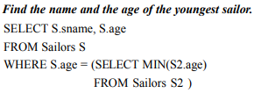

Find the age of the youngest sailor for each rating level.
Find the age of youngest sailor with age >= 18 for each rating with at least 2 such sailors

Slide 8
DROP/ALTER commands
Write a SQL statement to rename the table countries to country_new.
Write a SQL statement to add a column region_id to the table locations.
Write a SQL statement change the data type of the column country_id to integer in the table locations.
Write a SQL statement to drop the column city from the table locations.

Slide 9
Consider the following tables in Film Database: ARTIST (Art_id, Art_Name, Art_Gender) PRODUCER (Prod_id, Prod_Name, Prod_Phone) FILMS (Film_id, Film_Title, Film_Year, Film_Lang, Prod_id) CASTING (Art_id, Film_id, Part) REVIEW (Film_id, Stars)
Find the name of all the Films whose producer is “NIRAJ”
Display all artists who acted in a film between 2016 and 2018.
Display the names of films with the stars received and sort the result on the basis of stars.
Update the stars of all films whose producer is ‘NIRAJ’ to 5.

Slide 10
Thank you

